Slide 1
DeFi Introduction and Stablecoin
10/08/2021

Slide 2
Introduction
DeFi: Decentralized Finance
One of the fast-growing sectors in BC and CC
Soon DeFi will integrate with traditional finance system in future
Rapidly changing technology

Slide 3
Traditional Finance
The Banks
Financial industry giants
Facilitate payments, deposits, loc
Deposits, withdrawal, transfers, loans, etc.
Banks managed by humans and centralized system.
Prone to human-related risks such as mis-management and corruptions

Slide 4
Why DeFi
Seeks to build better financial landscape
Made possible to advent of the internet and blockchain technology
Particularly in 3 segments:
1. Payment and clearance system
Cryptocurrencies that power the DeFi movement allow you to bypass intermediaries
2. Accessibility
as of 2017, there are 1.7 billion people who do not own an account at a financial institution
two-thirds of the 1.7 billion unbanked population have access to mobile phones
Therefore, with an internet connection, DeFi Dapps can be the gateway for millions of people

Slide 5
Why DeFi
3. Centralized and transparency
traditional, regulated financial institutions are not without flaws
DeFi protocols built on top of public blockchains such as Ethereum are mostly open-sourced for audit and transparency purposes
have decentralized governing organizations to ensure that everyone knows what is happening and that no bad actors can single-handedly make bad decisions
you cannot cheat the codes as it treats every participant equally without discrimination

Slide 6
What is DeFi
DeFi is the movement that allows users to utilize financial services such as borrowing, lending, and trading without the need to rely on centralized entities
These financial services are provided via Decentralized Applications (Dapps), the majority of which are deployed on the Ethereum platform

Slide 7
What is DeFi
DeFi is not a single product or company
range of financial services:
banking, insurance, bonds, money markets and more
For DeFi Dapps to work, a collateral locked into smart contracts is usually required
These DeFi Dapps stand to revolutionize traditional financial services by removing the need for any middlemen.

Slide 8
DeFi Key Catagories
There are nine major categories of DeFi
Stable Coin
Lending and Borrowing
Exchanges
Derivatives
Fund Management
Lottery
Payments
Insurance
Governance

Slide 9
Decentralized StableCoins
Prices of cryptocurrencies are extremely volatile
Bitcoin, Ether, BNB, DogCoins are not stable
Imagine you order a pizza from bitcoin, and the time you order the price was equal to 10$ as soon as you receive order it may reaches 12$
To mitigate this problem stable coins came into the picture and DeFi introduces stable coins

Slide 10
Decentralized StableCoins
Small Market Cap
=
High Volatility

Slide 11
Types of StableCoins
Fiat-collateralized
USD-Peged (USDT – Tether)
Crypto-collateralized
DAI (TUSD)
Algorithmic stablecoins

Slide 12
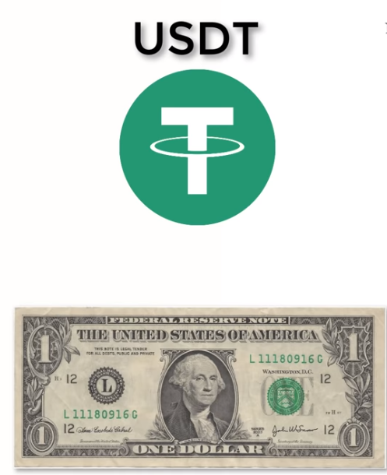
USDT
It is expected to maintain
same value no matter what.
It allows convenience of
Cryptocurrency alongwith
Some regulatory hurdles and
Stability of fiat currency .

Slide 13
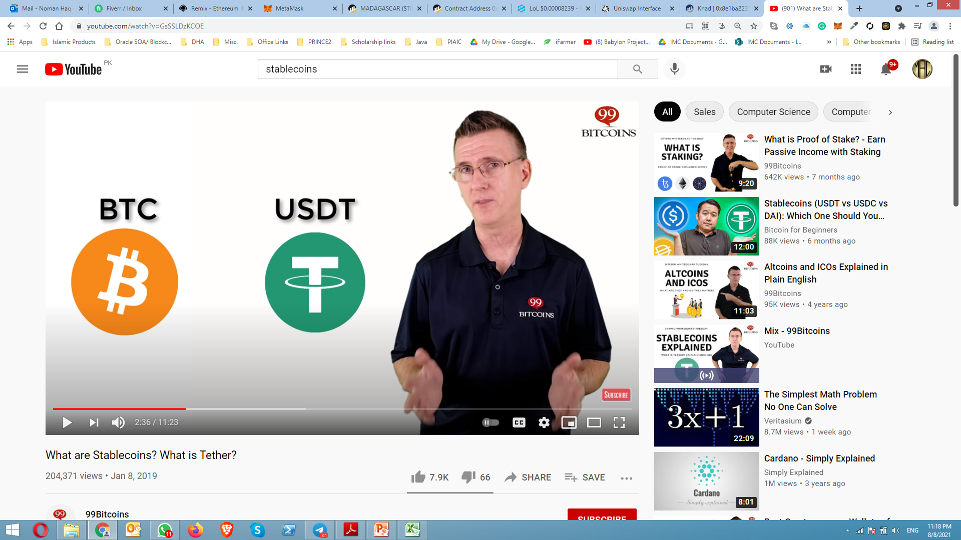
USDT
The most obvious use case is USDT use as medium of exchange for day to day
transactions with the exchange of USD$.
Another example of using USDT is for the traders who want to lower there risk with the
Fluctuation of BTC rates they just simply swap bitcoin with USDT
Notes:
https://www.youtube.com/watch?v=GsSSLDzKCOE

Slide 14
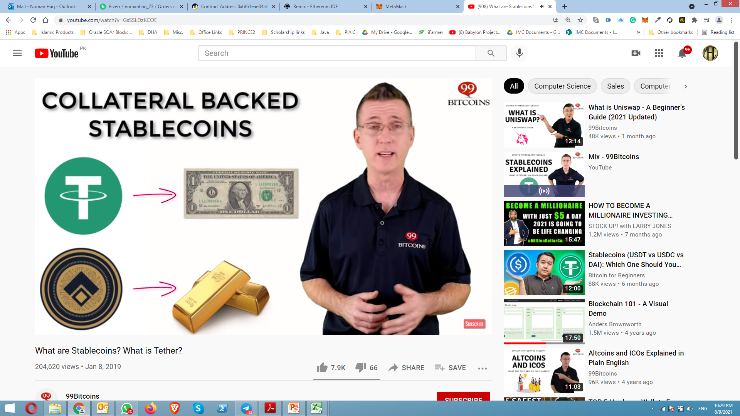
Collateral baked stablecoin
1 USDT is backed with Actual USD$
DGX Token is set to be backed by the Gold
Notes:
https://www.youtube.com/watch?v=GsSSLDzKCOE

Slide 15
Collateral Forms
Fiat (USD, EUR)
Assets (Gold, Oil)
Crypto (BTC, ETH)

Slide 16
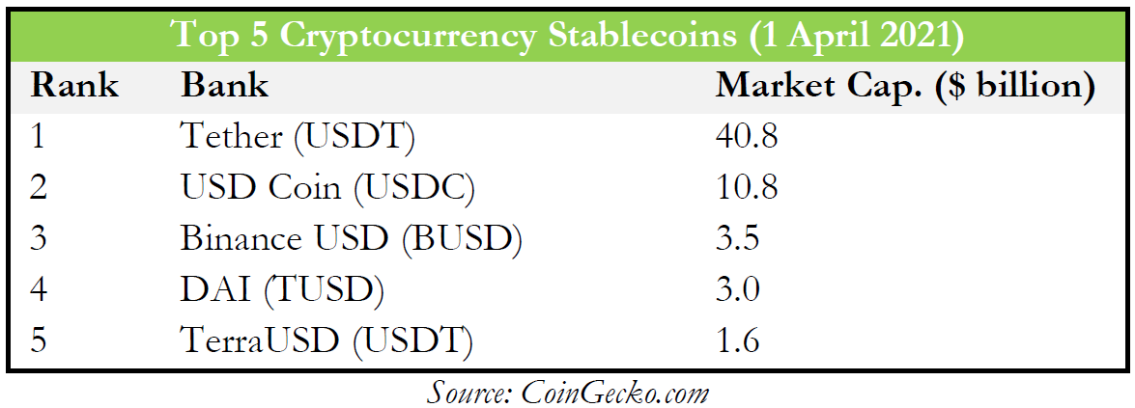
Top 5 Stablecoin

Slide 17

Is a smart contract runs on ethereum
DAI and it governance token MKR (Algorithmic paged)
Maker is type of organization like DAO (Decentralized Autonomous Organization)

Slide 18
DAI Ecosystem parameters
Collateral Ration
Minted DAI Depend on Collateral Ratio
wBTC = 150%, BAT = 150%
Stability Fees
Equivalent to interest rate
DAI Savings Rates (DSR)
Interest earned by holding DAI

Slide 19
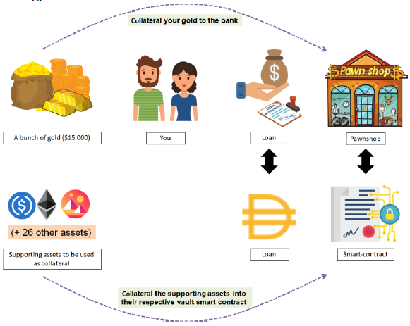
DAI Ecosystem parameters

Slide 20
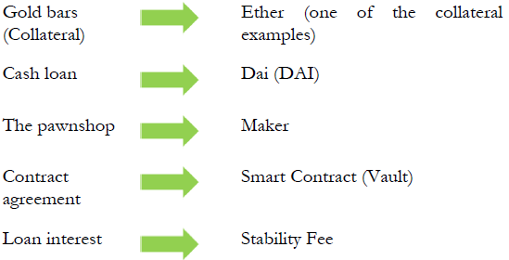
DAI Ecosystem parameters

Slide 21
MAKER Step by step
Go to https://oasis.app/
Click Borrow
You will be asked to connect your wallet. Connecting your wallet is free, all you need to do is sign a transaction
Click “Start Borrow” on the borrow page (https://oasis.app/borrow/)
Choose which cryptoasset you want to lock-in (collateralize)
In this example, we chose to lock-in ETH
Insert any amount you wish to lock. Note: The minimum amount of borrowing is 20 DAI
Click Continue and follow the instructions provided
Congratulations! Your ETH vault is now created!

Slide 22
Thank You

